Slide 1
CODF Transformation
Date goes here
Consolidated Plan Views

Slide 2
Views
  Analytic Apps: Daily Data
  Visualization Tools: AS & Data Integration/Validation, Data Visualization, Performance & Scalability
  Configuration Tools: Order Management
  Business Models & Rules: Business Rules, ILOG & QualityStage Plug-ins
  Data / Data Management: Data Cleansing & Scrubbing, ODS/DW, Dimensional Maintenance, Data Mart, Metadata, Future CODF Releases
  Infrastructure: Base Grid, Infrastructure Planning, Data Scoping & Security, Messaging, Mainframe Retirement

Slide 3
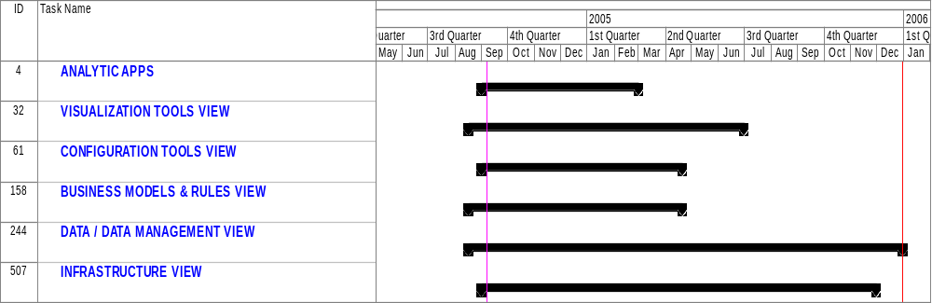
Top Line Summary

Slide 4
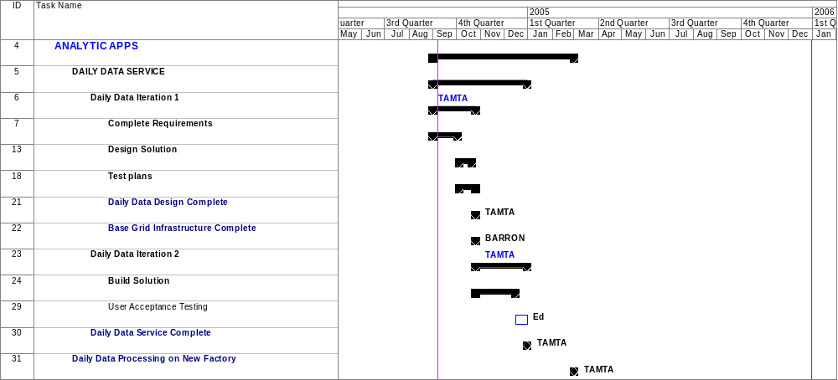
Analytic Apps

Slide 5
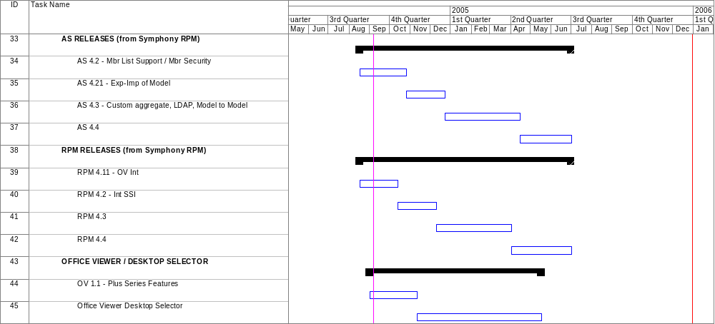
Visualization Tools (1)

Slide 6
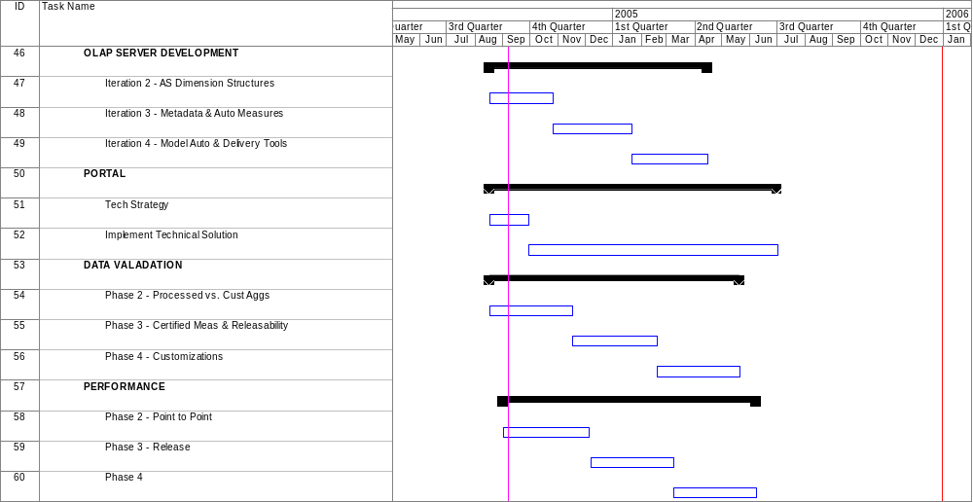
Visualization Tools (2)

Slide 7
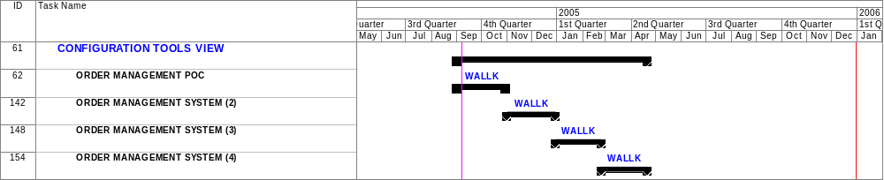
Configuration Tools

Slide 8
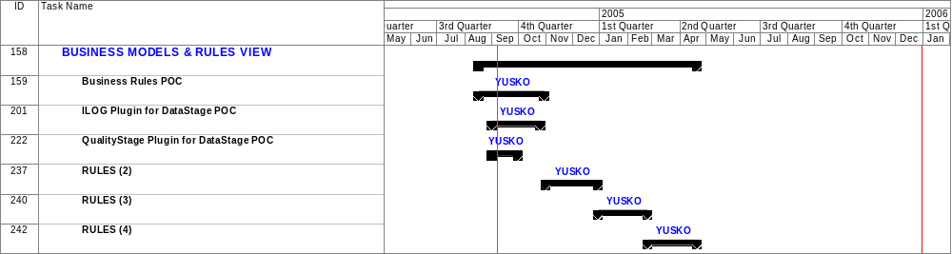
Business Models & Rules

Slide 9
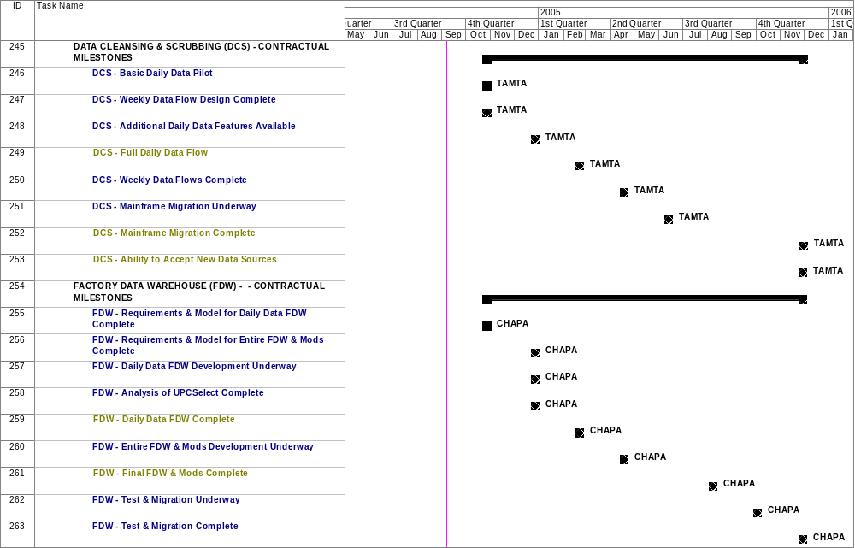
Data / Data Management (1)

Slide 10
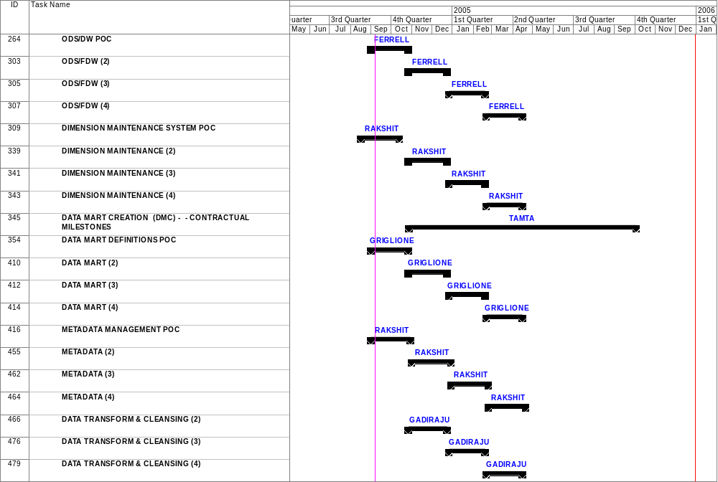
Data / Data Management (2)

Slide 11
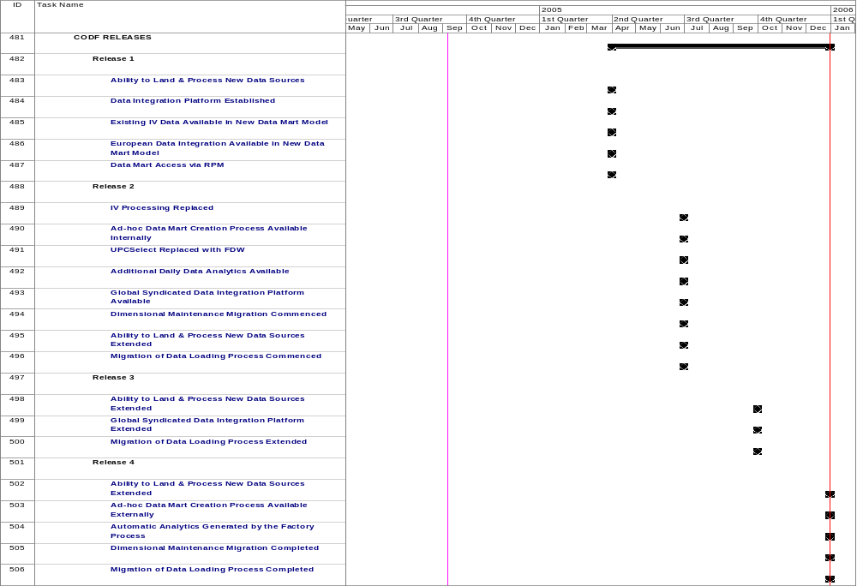
Data / Data Management (3)

Slide 12
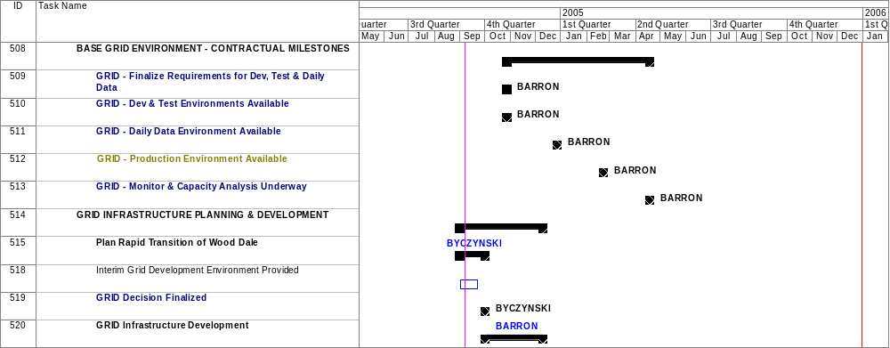
Infrastructure (1)

Slide 13
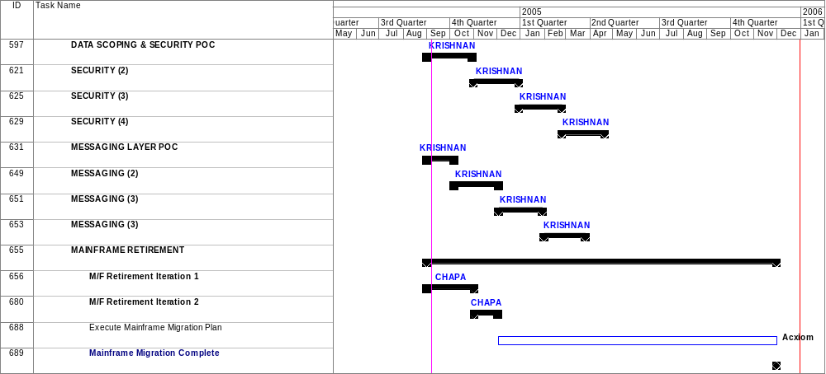
Infrastructure (2)

